Slide 1
Preparation and Guideline for Lab 4
Week 8
Dr. Farshid Keivanian

Slide 2
Preparation and Guideline for Lab 4
This PowerPoint is an optional guide designed to support your understanding of the official Lab 4 instructions. It includes step-by-step guidance for selected tasks.
Please follow the official Lab instructions and assessment requirements on Canvas when completing and submitting your work.

Slide 3
Preparation and Guideline for Lab 4
What are we building today?
We start with one network:
192.168.0.0/24
We need to divide it into smaller networks and then implement some of those networks in Cisco Packet Tracer.

Slide 4
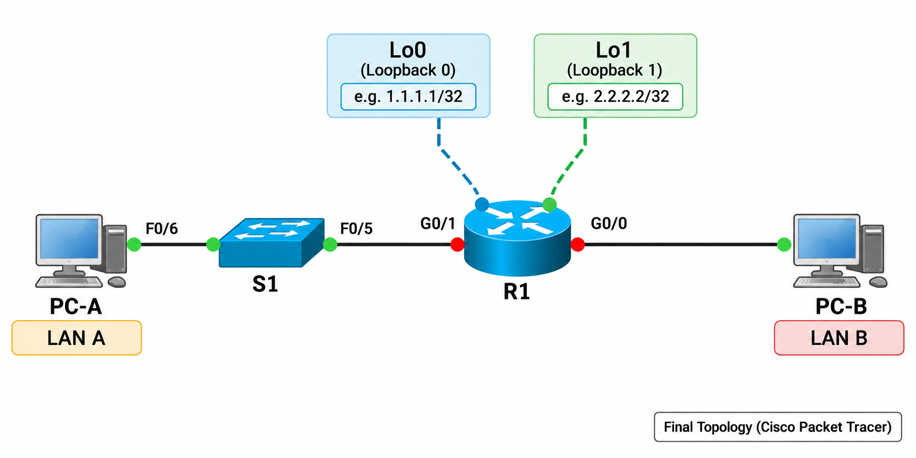
Preparation and Guideline for Lab 4
Today we will complete Tasks 1–4 together.
After that, you should have enough knowledge to complete Tasks 5–6 yourself.

Slide 5
Preparation and Guideline for Lab 4
Task 1 — Build the Network in Cisco Packet Tracer
Goal
First, we need to reproduce the physical topology.
We are not configuring IP addresses yet.
Why?
Because network design normally follows this sequence:

Slide 6
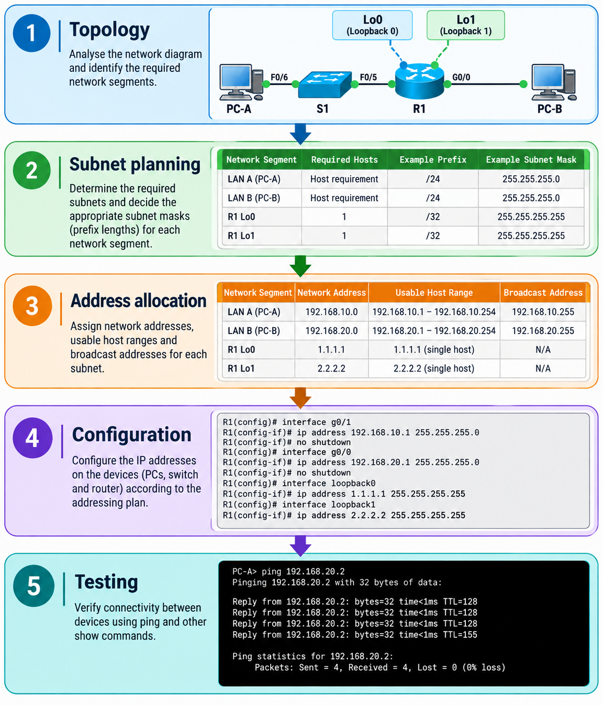
Preparation and Guideline for Lab 4

Slide 7
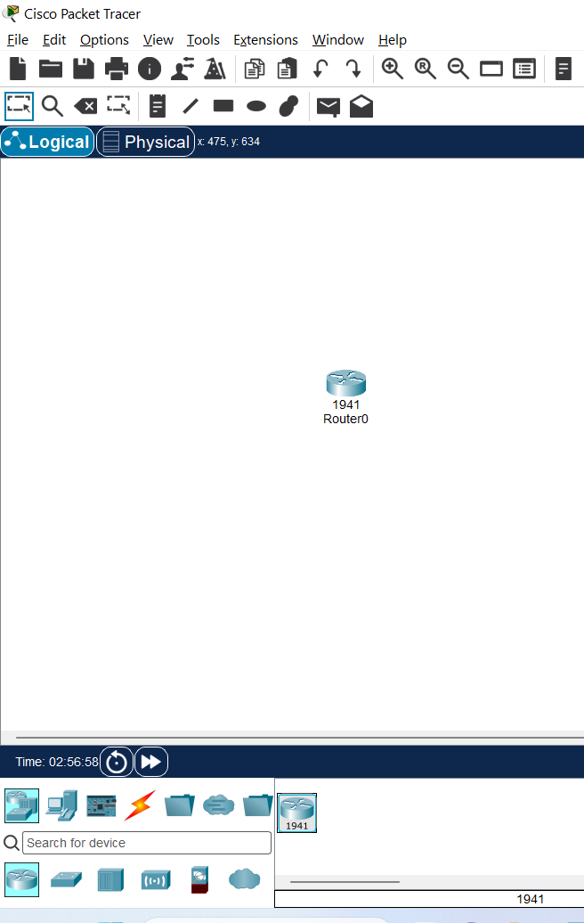
Preparation and Guideline for Lab 4
Step 1 — Add the router
You are currently on the Packet Tracer screen.
At the bottom-left, select:
Network Devices → Routers
Find:
1941
Drag Cisco 1941 Router onto the
workspace.
Rename it: R1

Slide 8

Preparation and Guideline for Lab 4
Step 1 — Add the router
You are currently on the Packet Tracer screen.
At the bottom-left, select:
Network Devices → Routers
Find:
1941
Drag Cisco 1941 Router onto the
workspace.
Rename it: R1

Slide 9
Preparation and Guideline for Lab 4
Why Cisco 1941?
The original lab was designed around the Cisco 1941 ISR.
It provides the interfaces we need:
GigabitEthernet0/0
GigabitEthernet0/1

Slide 10
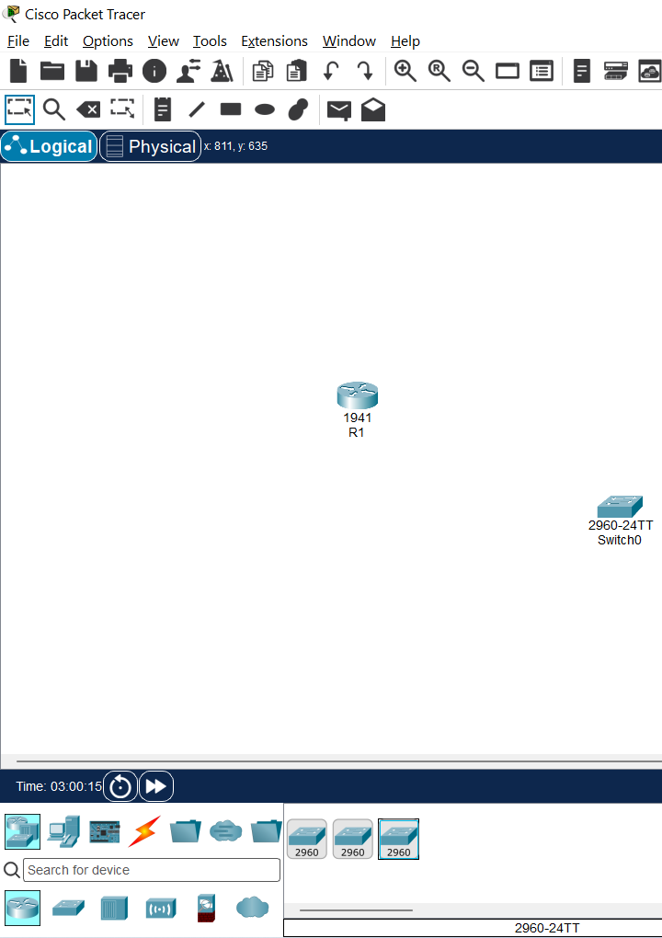
Preparation and Guideline for Lab 4
Step 2 — Add the switch
At the bottom-left select:
Network Devices → Switches
Find:
2960
Drag a Cisco 2960 switch onto
the workspace.
Name it: S1

Slide 11
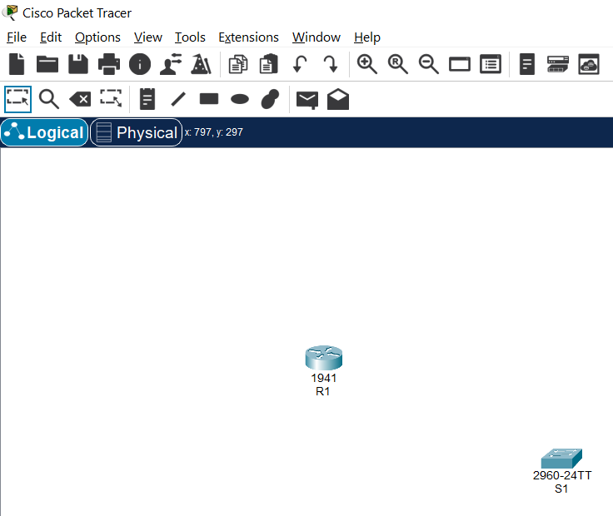
Preparation and Guideline for Lab 4
Select the 2960 switch, the one labelled:
2960-24TT
That is the best match for this lab and for the Cisco Catalyst 2960 device described in the instructions.
Do not select the middle 2960 with IOS 12 or the right 2960 IOS15 for this exercise

Slide 12
Preparation and Guideline for Lab 4
Why do we need a switch?
PC-A and R1 are on the same LAN.
The switch provides the Layer 2 connection between them.

Slide 13
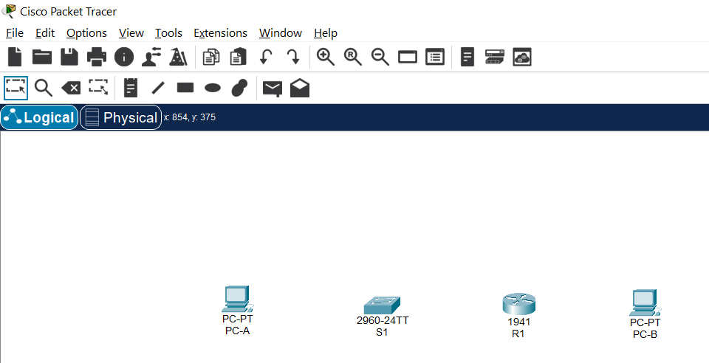
Preparation and Guideline for Lab 4
Step 3 — Add two PCs
Select:
End Devices → PC
Drag two PCs onto the workspace.
Name them:
PC-A
PC-B
Arrange them approximately like this:
PC-A ─── S1 ─── R1 ─── PC-B

Slide 14
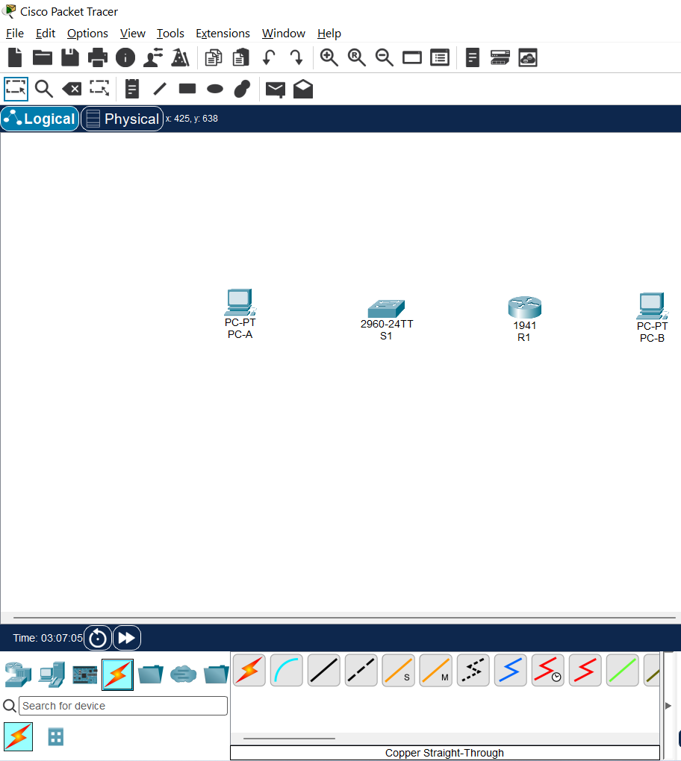
Preparation and Guideline for Lab 4
Step 4 — Connect PC-A to S1
At the bottom of Packet Tracer, click:
Connections ⚡
Choose:
Copper Straight-Through
Click:
PC-A
Choose:
FastEthernet0

Slide 15
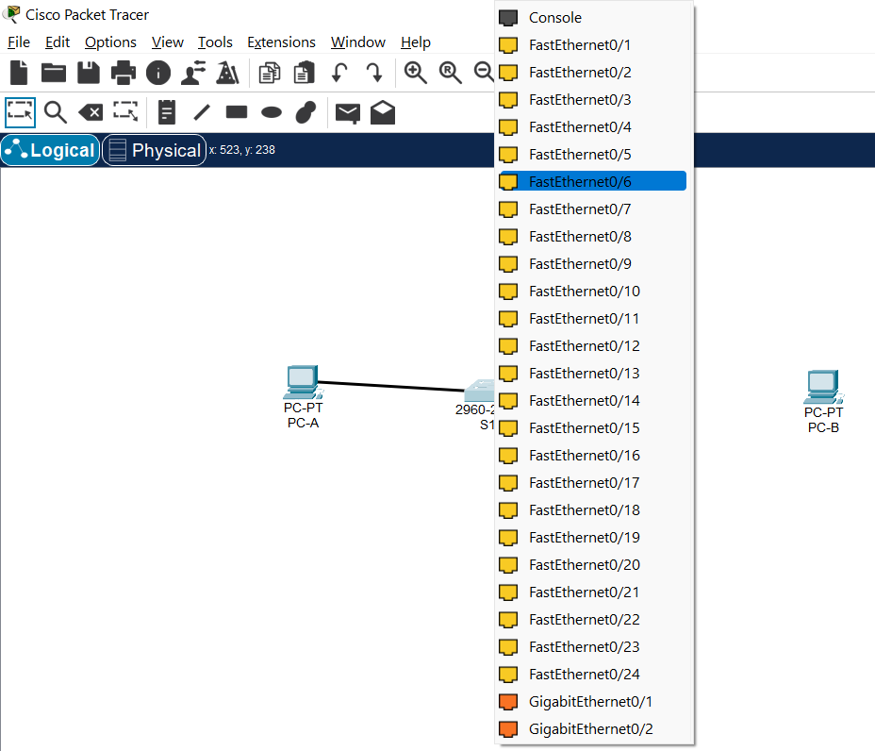
Preparation and Guideline for Lab 4
Then click:
S1
Choose:
FastEthernet0/6
Therefore:

Slide 16
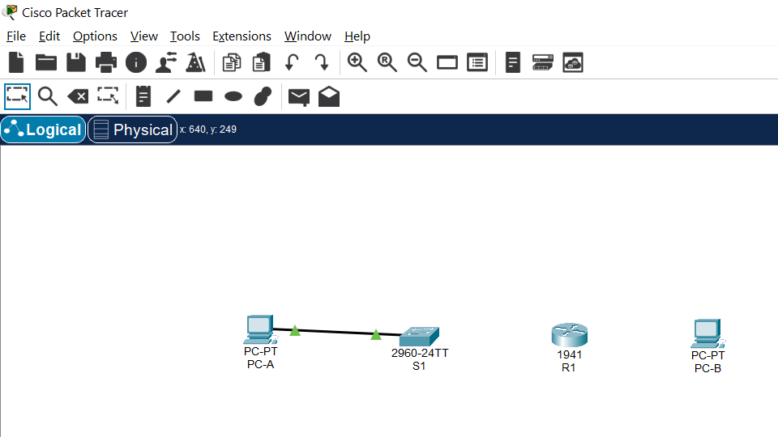
Preparation and Guideline for Lab 4
Why straight-through?
Traditionally, a straight-through Ethernet cable connects different device types, such as:
PC ↔ Switch
Router ↔ Switch
Packet Tracer may also
automatically select suitable cabling, but we want you to understand what the cable represents.

Slide 17
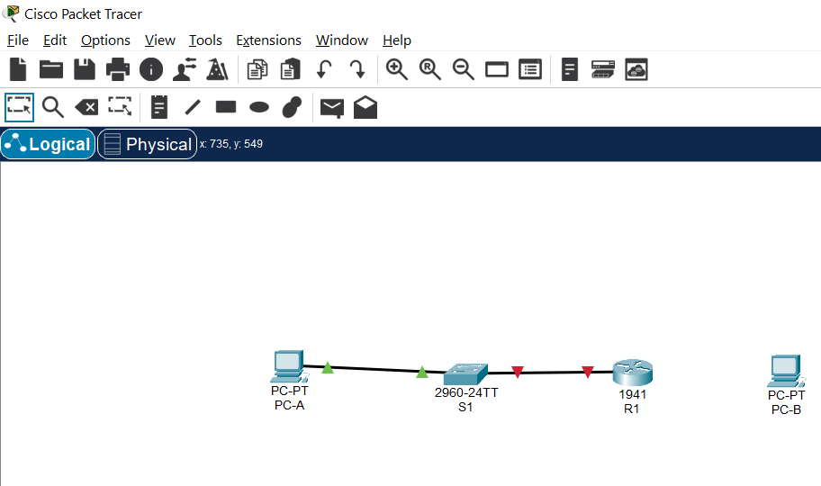
Preparation and Guideline for Lab 4
Step 5 — Connect S1 to R1
Again select:
Copper Straight-Through
Connect:
S1 FastEthernet0/5
to:
R1 GigabitEthernet0/1
So:
S1 F0/5 ───────── R1 G0/1
Notice something important:
F = FastEthernet
G = GigabitEthernet

Slide 18
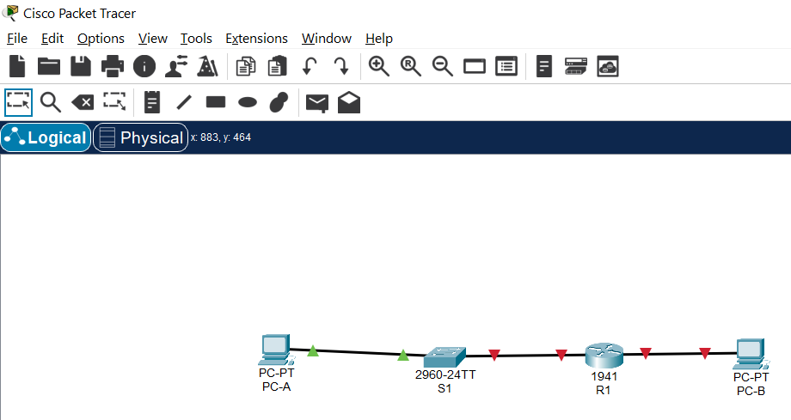
Preparation and Guideline for Lab 4
Step 6 — Connect R1 to PC-B
Connect:
R1 G0/0
to:
PC-B FastEthernet0
For the Cisco 1941 in this lab, you can use:
Copper Straight-Through
The lab notes that its Gigabit Ethernet interfaces support autosensing.

Slide 19
Preparation and Guideline for Lab 4
The green indicators on PC-A ↔ S1 show that link is up. The red indicators around R1 are expected at this stage if the router interfaces have not yet been enabled/configured. Cisco router Ethernet interfaces are typically administratively down until you issue:

Slide 20
Preparation and Guideline for Lab 4
What about Lo0 and Lo1?
We do not drag two more devices into Packet Tracer.
Lo0 and Lo1 are virtual interfaces inside R1.
We will create them later using IOS commands.

Slide 21
Preparation and Guideline for Lab 4
Task 2 — Design the Subnetting Scheme
Now we move from physical design to logical design.
We have:
192.168.0.0/24
Requirements:
Employee LAN ≥ 25 hosts
Administration LAN ≥ 10 hosts
Loopback 0 1 subnet
Loopback 1 1 subnet
Future network 1 subnet
Future network 1 subnet

Slide 22
Preparation and Guideline for Lab 4
Therefore, how many subnets do we need?
6 subnets minimum
And what is our largest host requirement?
25 hosts

Slide 23
Preparation and Guideline for Lab 4
Step 1 — Understand the original /24
A /24 means:
11111111.11111111.11111111.00000000
or:
255.255.255.0
The 1s identify the: Network portion
The 0s identify the: Host portion
We currently have:
24 network bits
8 host bits

Slide 24
Preparation and Guideline for Lab 4
Step 2 — How many bits should we borrow?
We need at least:
6 subnets
Remember:
Number of subnets = 2^n
where n is the number of borrowed bits.
Try 2 bits: 2² = 4
Is 4 enough?
No

Slide 25
Preparation and Guideline for Lab 4
Try 3 bits:
2³ = 8
Is 8 enough?
Yes
Therefore, we borrow:
3 bits
Our original prefix was:
/24
So: 24 + 3 = 27
Our new prefix is therefore: /27

Slide 26
Preparation and Guideline for Lab 4
Step 3 — Convert /27 into a subnet mask
Binary:
11111111.11111111.11111111.11100000
Decimal:
255.255.255.224
Therefore:
/27 = 255.255.255.224

Slide 27
Preparation and Guideline for Lab 4
Step 4 — Check the number of hosts
With /27, how many host bits remain?
32 - 27 = 5
Total addresses:
2⁵ = 32
But two addresses cannot normally be assigned to hosts:
Network address
Broadcast address
Therefore:
32 - 2 = 30 usable hosts

Slide 28
Preparation and Guideline for Lab 4
Our largest network needs:
25 hosts
and /27 provides:
30 usable hosts
So /27 satisfies both requirements:
8 subnets
30 usable hosts per subnet

Slide 29
Preparation and Guideline for Lab 4
Quick Comparison
Prefix | Mask | Subnets from /24 | Usable hosts/subnet
/25 | 255.255.255.128 | 2 | 126
/26 | 255.255.255.192 | 4 | 62
/27 | 255.255.255.224 | 8 | 30
/28 | 255.255.255.240 | 16 | 14
/29 | 255.255.255.248 | 32 | 6
/30 | 255.255.255.252 | 64 | 2

Slide 30
Preparation and Guideline for Lab 4
Why can't we use /28?
Because although /28 creates enough subnets, each subnet has only:
14 usable addresses
The employee network requires at least:
25

Slide 31
Preparation and Guideline for Lab 4
Task 3 — Calculate the Subnets and Allocate Addresses
Now that we know:
/27
we need to identify the actual subnet addresses.
Step 1 — Find the block size
Use:
256 - 224 = 32
Therefore, subnet addresses increase by:
32
Starting at 0:

Slide 32
Preparation and Guideline for Lab 4
0
32
64
96
128
160
192
224

Slide 33
Preparation and Guideline for Lab 4
Therefore our eight /27 networks are:
# | Network | Usable host range | Broadcast
1 | 192.168.0.0/27 | 192.168.0.1–30 | 192.168.0.31
2 | 192.168.0.32/27 | 192.168.0.33–62 | 192.168.0.63
3 | 192.168.0.64/27 | 192.168.0.65–94 | 192.168.0.95
4 | 192.168.0.96/27 | 192.168.0.97–126 | 192.168.0.127
5 | 192.168.0.128/27 | 192.168.0.129–158 | 192.168.0.159
6 | 192.168.0.160/27 | 192.168.0.161–190 | 192.168.0.191
7 | 192.168.0.192/27 | 192.168.0.193–222 | 192.168.0.223
8 | 192.168.0.224/27 | 192.168.0.225–254 | 192.168.0.255
We need six of these eight.

Slide 34
Preparation and Guideline for Lab 4
Step 2 — Assign the first four subnets
The instructions tell us:
On the router, use the first usable address in each subnet.
Let's assign:
Subnet 1 → G0/0 network
Subnet 2 → G0/1 network
Subnet 3 → Lo0
Subnet 4 → Lo1
Subnet 5 → Future use
Subnet 6 → Future use

Slide 35
Preparation and Guideline for Lab 4
Therefore: R1 G0/0
Subnet:
192.168.0.0/27
First usable:
192.168.0.1
So:
R1 G0/0 = 192.168.0.1/27
PC-B can use another valid host address, for example:
PC-B = 192.168.0.2/27
Gateway = 192.168.0.1

Slide 36
Preparation and Guideline for Lab 4
R1 G0/1
Subnet:
192.168.0.32/27
First usable:
192.168.0.33
Therefore:
R1 G0/1 = 192.168.0.33/27
PC-A can use:
PC-A = 192.168.0.34/27
Gateway = 192.168.0.33

Slide 37
Preparation and Guideline for Lab 4
Loopback 0
Third subnet:
192.168.0.64/27
First usable:
192.168.0.65
Therefore:
Lo0 = 192.168.0.65/27

Slide 38
Preparation and Guideline for Lab 4
Loopback 1
Fourth subnet:
192.168.0.96/27
First usable:
192.168.0.97
Therefore:
Lo1 = 192.168.0.97/27

Slide 39
Preparation and Guideline for Lab 4
Our Addressing Table
Device | Interface | IP Address | Subnet Mask | Default Gateway
R1 | G0/0 | 192.168.0.1 | 255.255.255.224 | N/A
R1 | G0/1 | 192.168.0.33 | 255.255.255.224 | N/A
R1 | Lo0 | 192.168.0.65 | 255.255.255.224 | N/A
R1 | Lo1 | 192.168.0.97 | 255.255.255.224 | N/A
S1 | VLAN 1 | N/A | N/A | N/A
PC-A | NIC | 192.168.0.34 | 255.255.255.224 | 192.168.0.33
PC-B | NIC | 192.168.0.2 | 255.255.255.224 | 192.168.0.1

Slide 40
Preparation and Guideline for Lab 4
Why isn't the default gateway 192.168.0.1 for both PCs?
Because a host's gateway must be an address on the same local subnet as that host.
PC-B belongs to:
192.168.0.0/27
so:
Gateway = 192.168.0.1
PC-A belongs to: 192.168.0.32/27
so: Gateway = 192.168.0.33

Slide 41
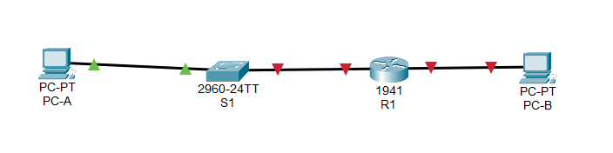
Preparation and Guideline for Lab 4
Task 4 — Configure Router R1 Together
Now we convert our addressing plan into an actual router configuration.
The green triangles on the PC-A ↔ S1 connection show that link is up. The red triangles around R1 are expected right now because the router's physical interfaces have not yet been enabled with no shutdown.

Slide 42
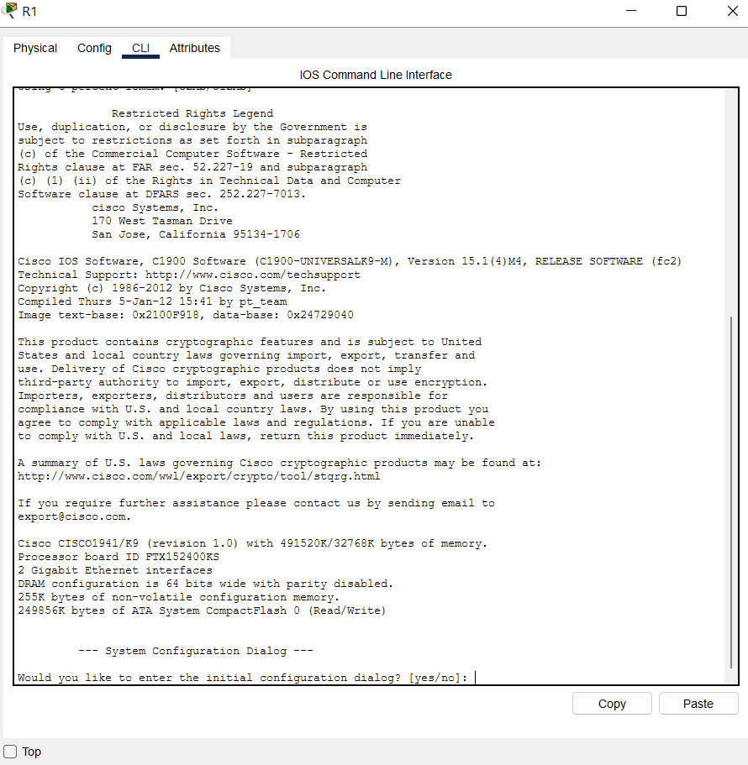
Preparation and Guideline for Lab 4
Click: R1
Select: CLI
If Packet Tracer asks:
Would you like to enter the
initial configuration dialog?
[yes/no]:
enter: no
Press Enter if necessary.

Slide 43
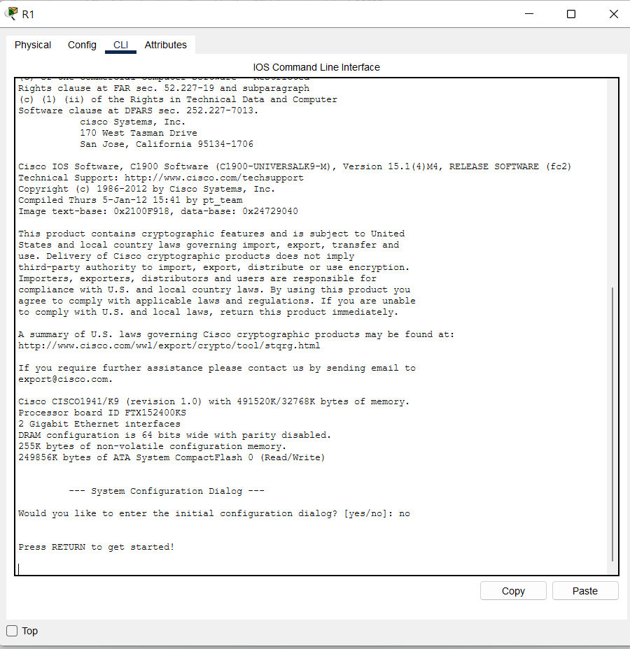
Preparation and Guideline for Lab 4
Click: R1
Select: CLI
If Packet Tracer asks:
Would you like to enter the
initial configuration dialog?
[yes/no]:
enter: no
Press Enter if necessary.

Slide 44
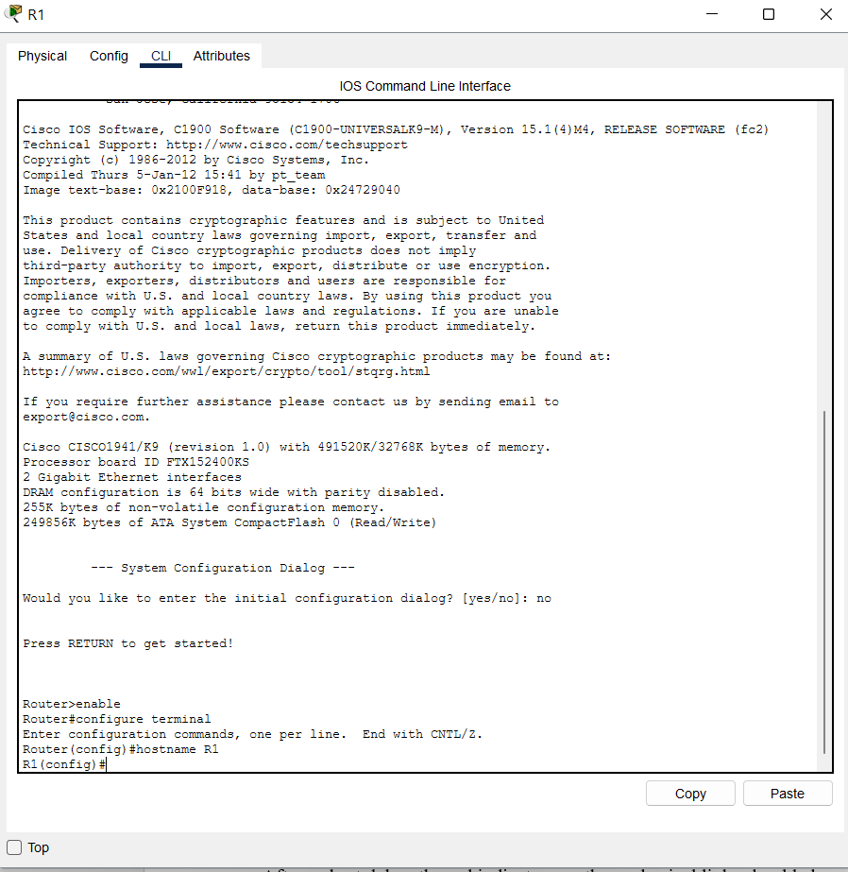
Preparation and Guideline for Lab 4
Step 1 — Enter privileged mode
You should see:
Router>
Enter: enable
Now: Router#
Why?
> represents user EXEC mode.
# represents privileged EXEC
mode, which gives us access to administrative commands.

Slide 45
Preparation and Guideline for Lab 4
Step 2 — Enter configuration mode
configure terminal
You should see:
Router(config)#
Now we can change the
router's configuration.

Slide 46
Preparation and Guideline for Lab 4
Step 3 — Rename the router
hostname R1
The prompt changes to:
R1(config)#
This makes it much easier to
identify which device we are
configuring.

Slide 47
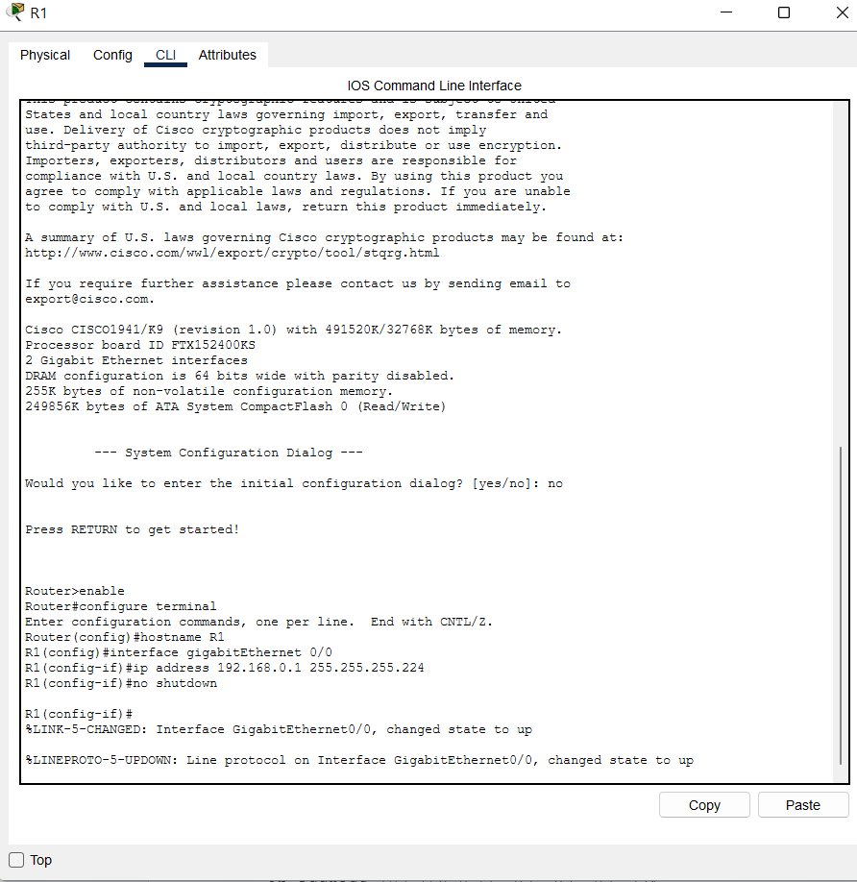
Preparation and Guideline for Lab 4
Step 4 — Configure G0/0
Enter:
interface gigabitEthernet 0/0
Then:
ip address 192.168.0.1 255.255.255.224
Then:
no shutdown

Slide 48
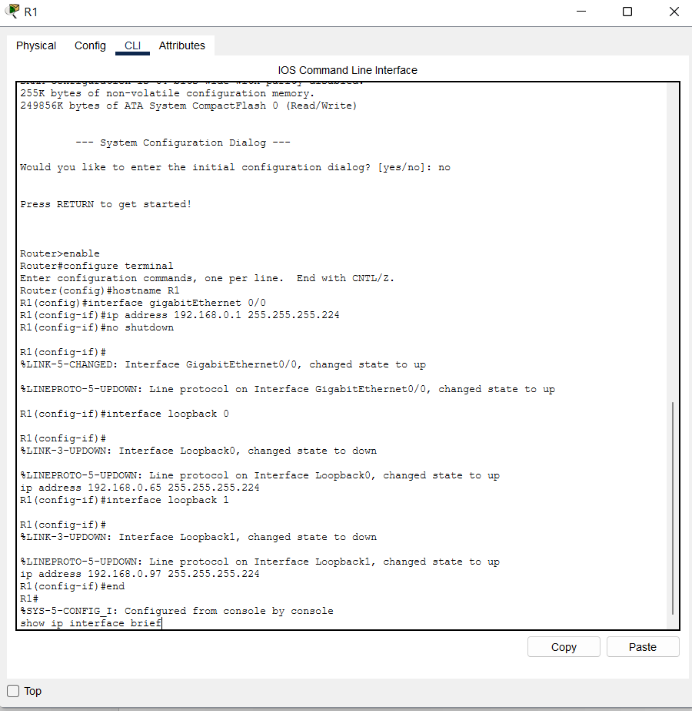
Preparation and Guideline for Lab 4
Why no shutdown?
Physical router interfaces are commonly administratively disabled initially.
no shutdown enables the interface.
You may shortly see messages such as:
%LINK-5-CHANGED
%LINEPROTO-5-UPDOWN
indicating that the interface/link state
has changed.

Slide 49
Preparation and Guideline for Lab 4
Step 5 — Configure G0/1
Enter: interface gigabitEthernet 0/1
Then: ip address 192.168.0.33 255.255.255.224
Then: no shutdown
Now our two physical router interfaces belong to two different networks:
G0/0 → 192.168.0.0/27
G0/1 → 192.168.0.32/27
This is important.
A router connects different IP
networks.

Slide 50
Preparation and Guideline for Lab 4
Step 6 — Create Loopback 0
Enter: interface loopback 0
Then: ip address 192.168.0.65 255.255.255.224
Notice we don't need:
no shutdown
because loopback interfaces are enabled
when created.
What exactly is a loopback?
It is a virtual interface.
There is no physical cable and no extra device.
Here we use it to simulate another LAN/network attached to R1.

Slide 51
Preparation and Guideline for Lab 4
Step 7 — Create Loopback 1
Enter:
interface loopback 1
Then:
ip address 192.168.0.97 255.255.255.224

Slide 52
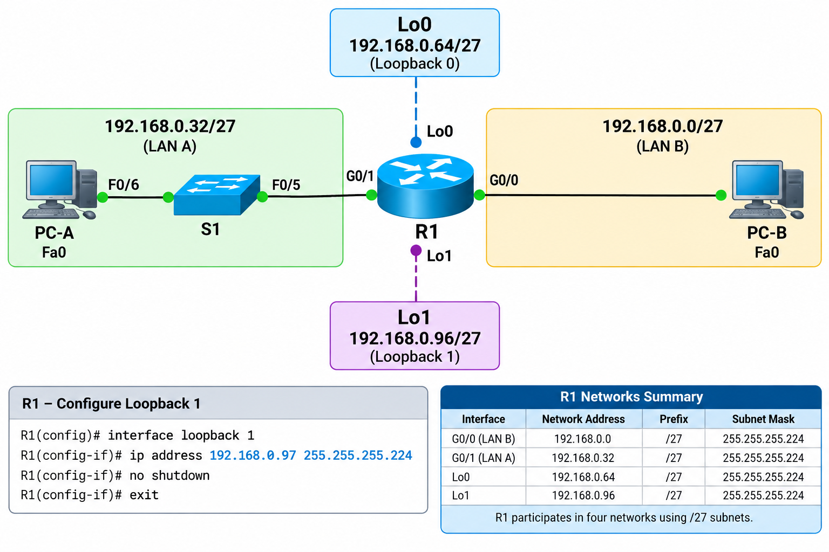
Preparation and Guideline for Lab 4

Slide 53
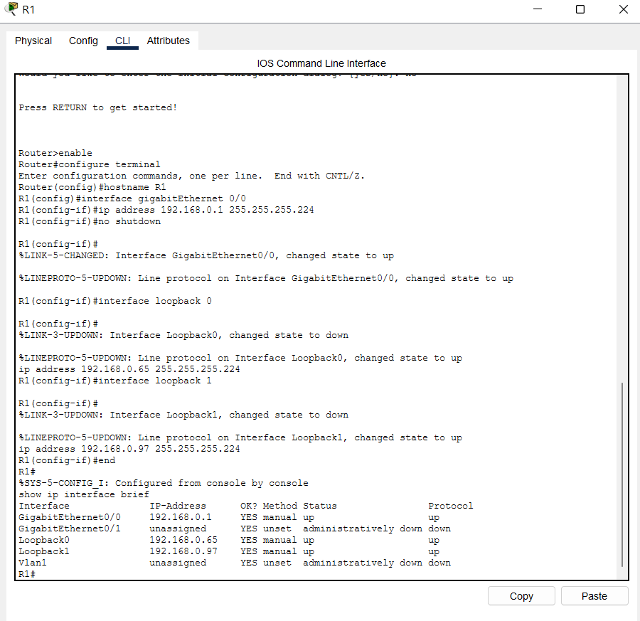
Preparation and Guideline for Lab 4
Step 8 — Verify before continuing
Enter: end
Then: show ip interface brief
Look for something similar to:
Interface IP-Address
GigabitEthernet0/0 192.168.0.1
GigabitEthernet0/1 192.168.0.33
Loopback0 192.168.0.65
Loopback1 192.168.0.97
For the active interfaces, we ultimately want to see:
Status Protocol
up up
This command is extremely useful for troubleshooting.

Slide 54
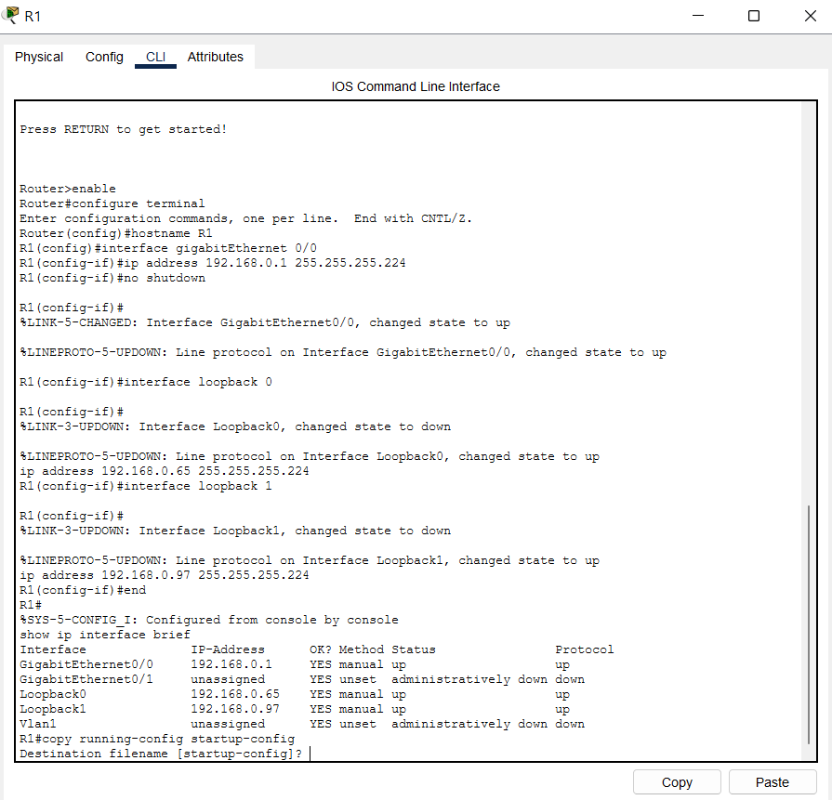
Preparation and Guideline for Lab 4
Step 9 — Save your work
Enter:
copy running-config startup-config
Press Enter when prompted for the destination filename.
Why?
Think of:
running-config
as what the router is using right now.

Slide 55
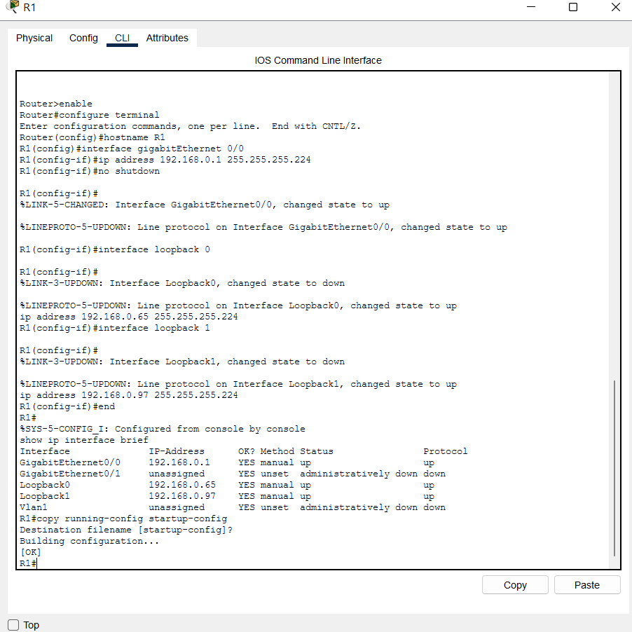
Preparation and Guideline for Lab 4
And:
startup-config
as what the router should load when it starts again.
So saving protects our
configuration.

Slide 56
Preparation and Guideline for Lab 4
Stop Point — Now Students Take Over
At this point, we have completed roughly two-thirds of the lab together.
You now know how to:
✓ Build a topology
✓ Select Ethernet interfaces
✓ Calculate the required prefix
✓ Determine subnet ranges
✓ Allocate IP addresses
✓ Configure router interfaces
✓ Create loopback interfaces
✓ Verify router interfaces
✓ Save a configuration
So for the remaining tasks, I will give you hints rather than every click and command.

Slide 57
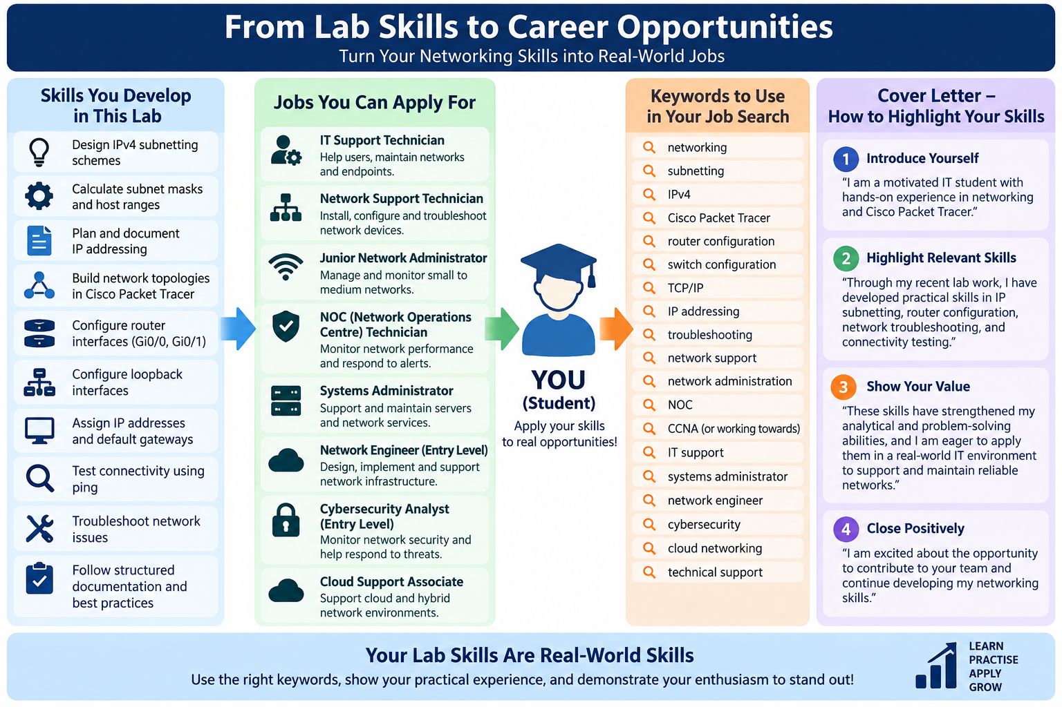
Preparation and Guideline for Lab 4

Slide 58
Preparation and Guideline for Lab 4
We completed selected tasks together. You have now learned how to design a subnetting scheme from a /24 network, determine the required subnet mask and host ranges, allocate IP addresses to different subnets, build the network topology in Cisco Packet Tracer, and configure router physical and loopback interfaces. You have gained the core skills and knowledge required to complete the remaining PC configuration, connectivity testing, troubleshooting, and reflection activities independently.

Slide 59
Submission of Labs & Assessments
These guidelines are designed to support your learning and help you apply necessary techniques effectively. Please do the remaining task and follow the instructions based on Canvas. If you have any questions, feel free to ask—I’m happy to help!

Slide 60
Preparation and Guideline for Lab 4
You are encouraged to discuss concepts and work alongside classmates, but your final work, screenshots, explanations, and submission must reflect your own understanding and work.

Slide 61
Preparation and Guideline for Lab 4
Do not share completed submissions or copy another student’s work. Each student must submit individually through Canvas, and submissions may be reviewed using Turnitin and other academic integrity processes.
Make sure you can run your program, explain your work, and demonstrate your understanding.

Slide 62

Let’s Answer Your Questions
Live during class – Ask directly during sessions.
Canvas Inbox – For structured academic queries.
Email – For formal communications or attachments.
Canvas Discussion Forum – Everyone can see and learn from your question.

Slide 63

Thank You
Happy Learning and Bright Futures Ahead!
Stay Connected:
linkedin.com/in/farshid-keivanian
github.com/FarshidKeivanian
Education is the most powerful weapon you can use to change the world. — Nelson Mandela

